Slide 1
Capstone Project Thomas Cook Tour
Prepared by: Abhishek Kumar Karn
Superset Id: 4634167
Java Selenium Batch – 4
GitHub Repository Link - https://github.com/karnabhishek/Capstone-Project-Thomas_Cook_Tour.git

Slide 2
Tools & Technologies Used
• Automation tool: selenium WebDriver
• Programming language: JAVA
• Test framework: TestNG
• Build tool: Maven
• Reporting: Extent reports
• Design pattern: page object model (POM)
• Input Data: Excel Sheet

Slide 3
Workflow
1. Test execution triggered via TestNG.
2. Driver initialized via DriverFactory.
3. Test steps executed using page objects.
4. Results captured in extent report.
5. Screenshots on every cases.

Slide 4
Implementation Details
• Used maven for dependency management.
• TestNG to define test suites.
• Extent reports integrated for reporting.
• Logging maintained for debugging.

Slide 5
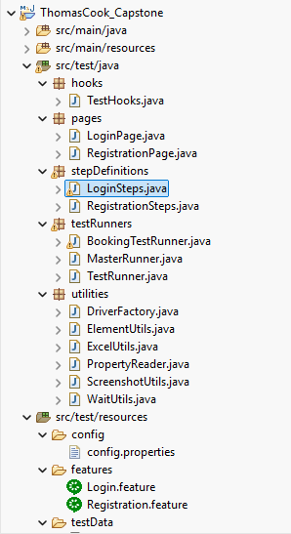
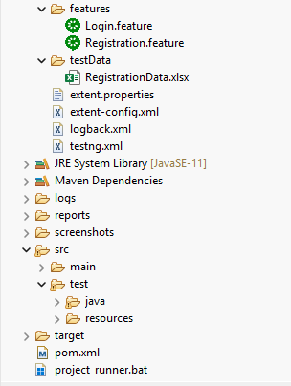
Project Structure

Slide 6
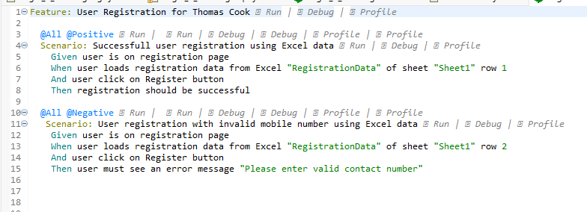
Feature Files
Registeration.feature

Slide 7
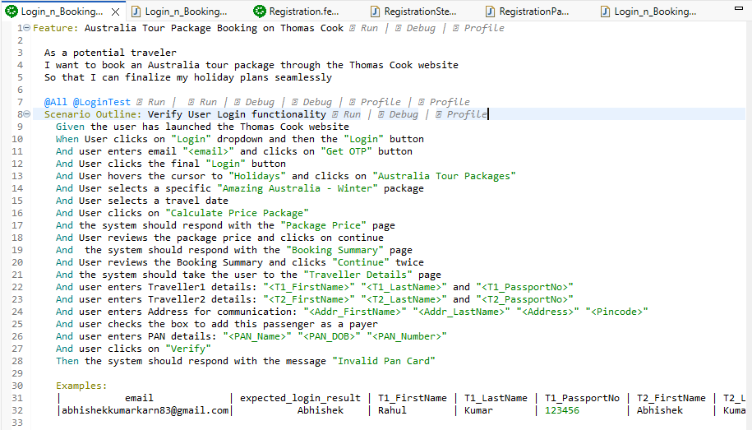
Login_n_Booking.feature

Slide 8
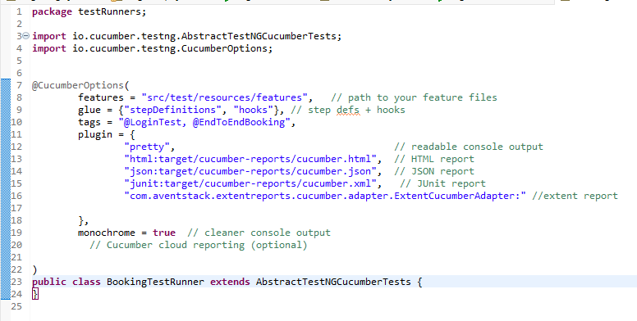
LoginTestRunner.java

Slide 9
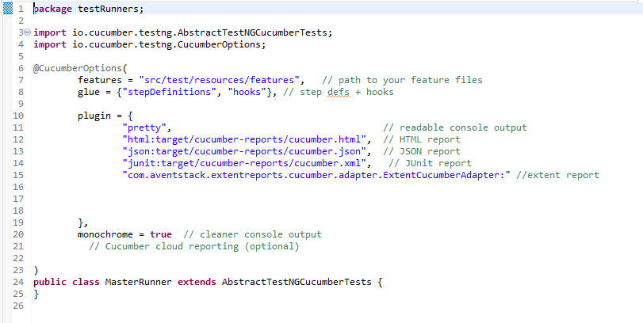
MasterRunner.java

Slide 10
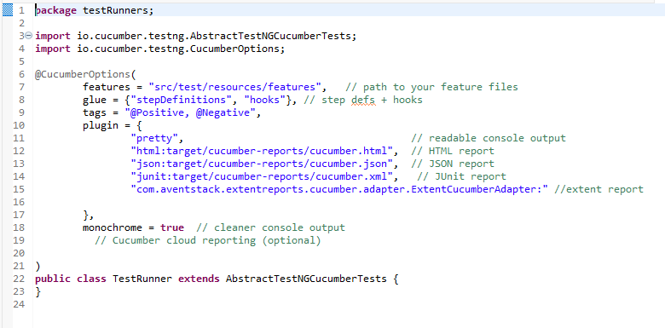
TestRunner.java

Slide 11
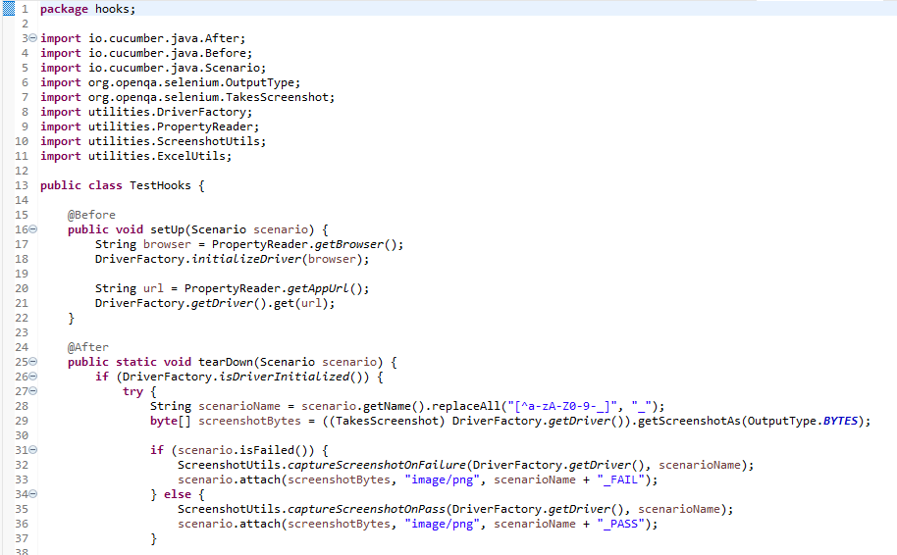
TestHooks.java

Slide 12
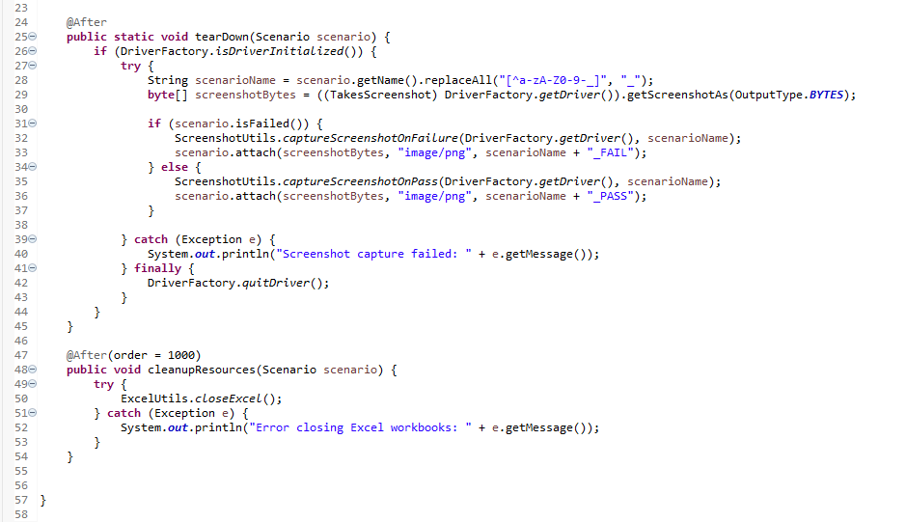
TestHooks

Slide 13
Step Definition
Purpose:
Implements the actual code for each step written in the feature file.
Connects plain english steps (gherkin) to java methods.
Key points:
Each step in the feature file (given, when, and, then) has a corresponding java method.
Allows reusable and maintainable automation code.
Includes selenium actions like clicking, typing, navigating, and validations.
Works with hooks and runner class to execute scenarios and generate reports.

Slide 14
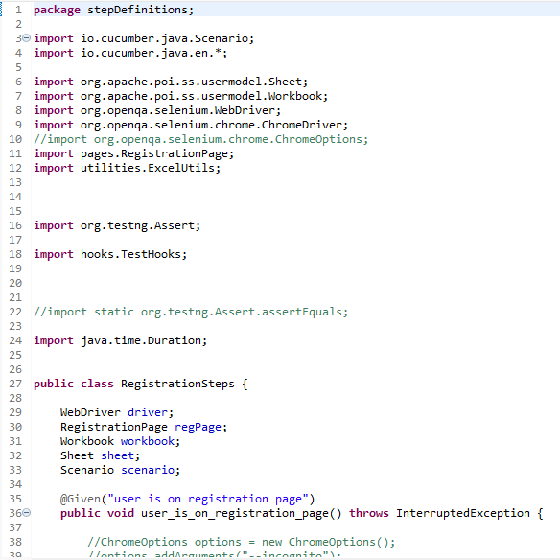
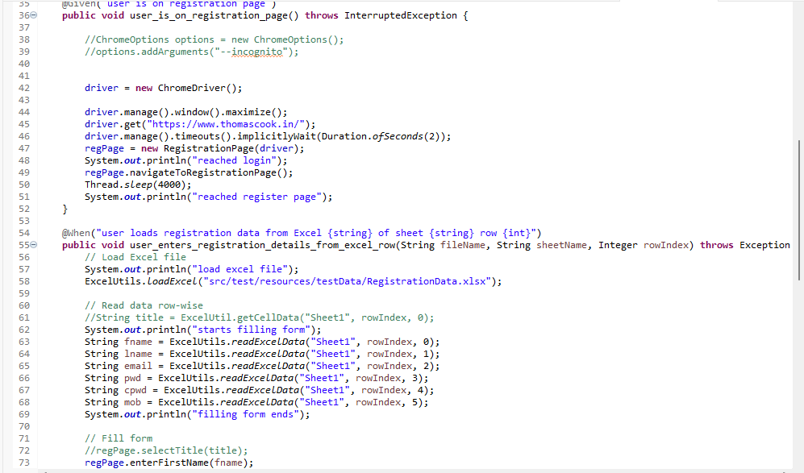
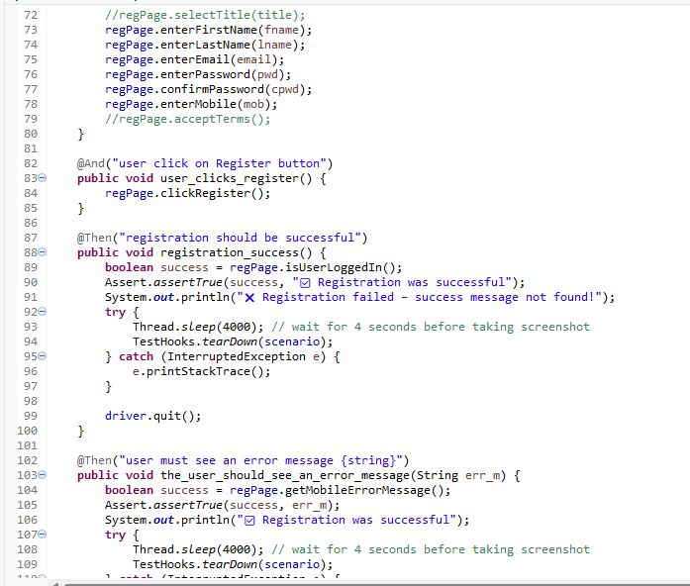
RegisterationSteps.java

Slide 15
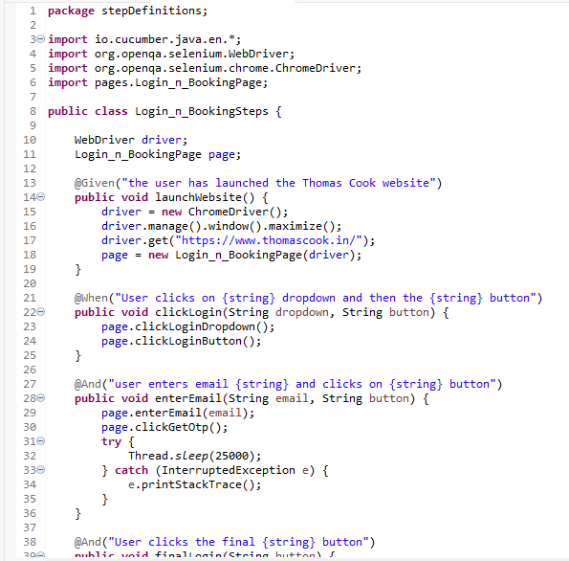
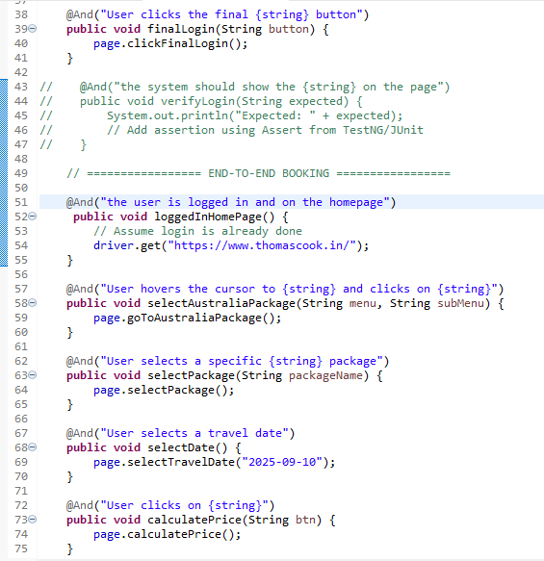
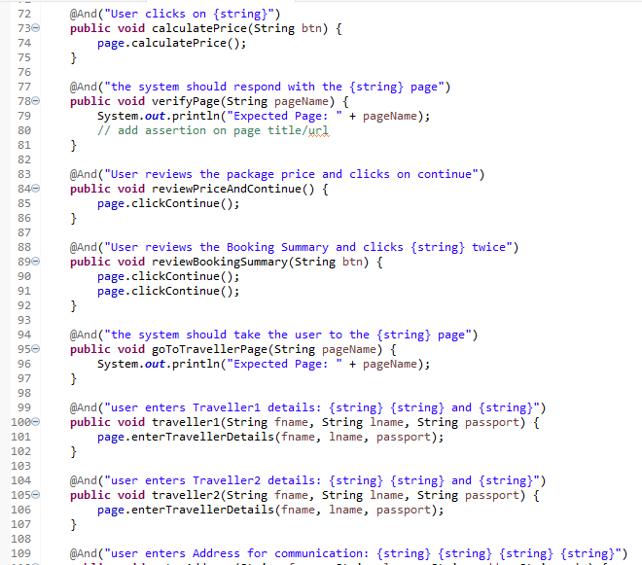
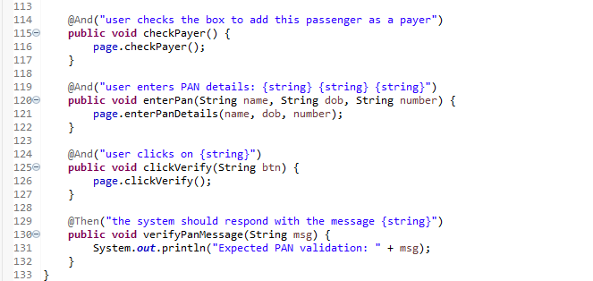
Login_n_Booking.java

Slide 16
Page Object Model (POM) Class
Purpose
POM is a design pattern used in selenium automation.
It helps to separate test logic from ui element locators.
Each web page of the application is represented as a class in the framework.
Key points
Encapsulation: UI locators & methods for a page are stored in one class.
Reusability: methods can be reused across multiple scenarios.
Maintainability: if a locator changes, update only in one place.
Works with step definitions to perform actions.
Improves readability and structure of automation framework.

Slide 17
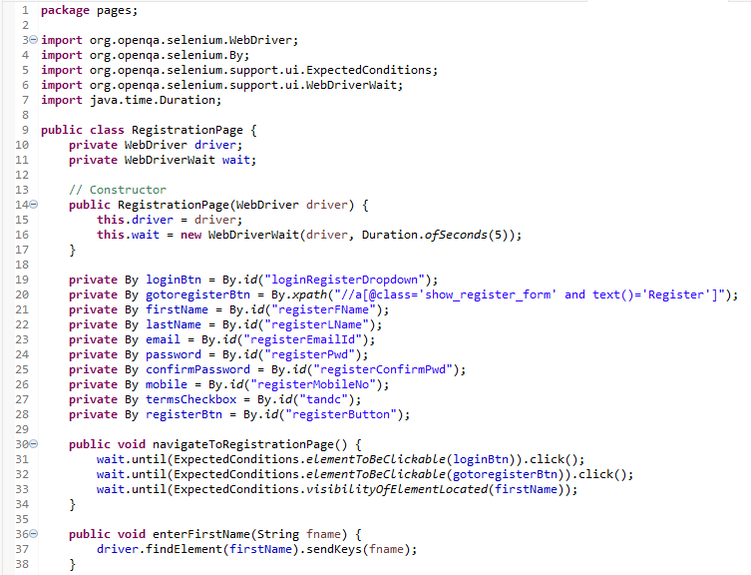
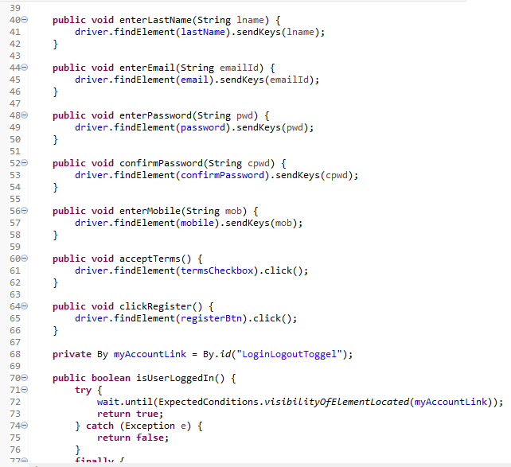
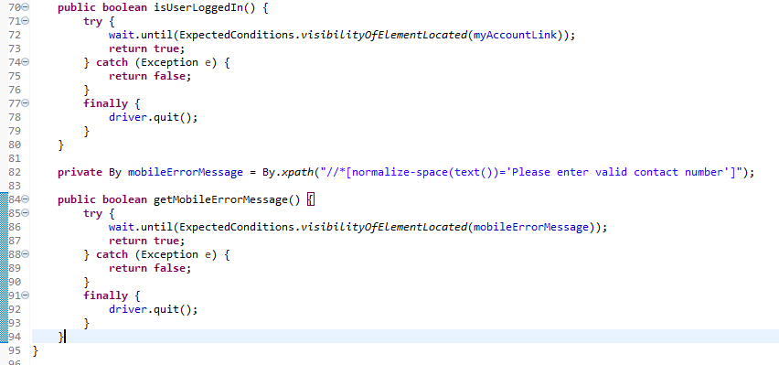
Registration page

Slide 18
Extent Reports
Purpose:
Provide a clear summary of test execution.
Help testers and stakeholders quickly understand results.
Key points:
Extent reports generate HTML reports with pass/fail status.
Include step-wise logs, screenshots, and scenario details.
Helps in analyzing failures and improving test coverage.
Supports visual summaries and dashboards for easy sharing.

Slide 19
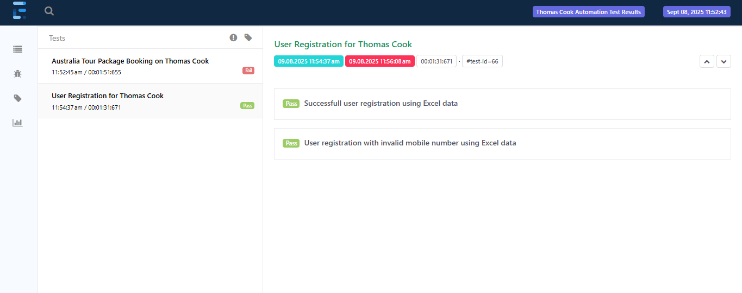
extent.html

Slide 20
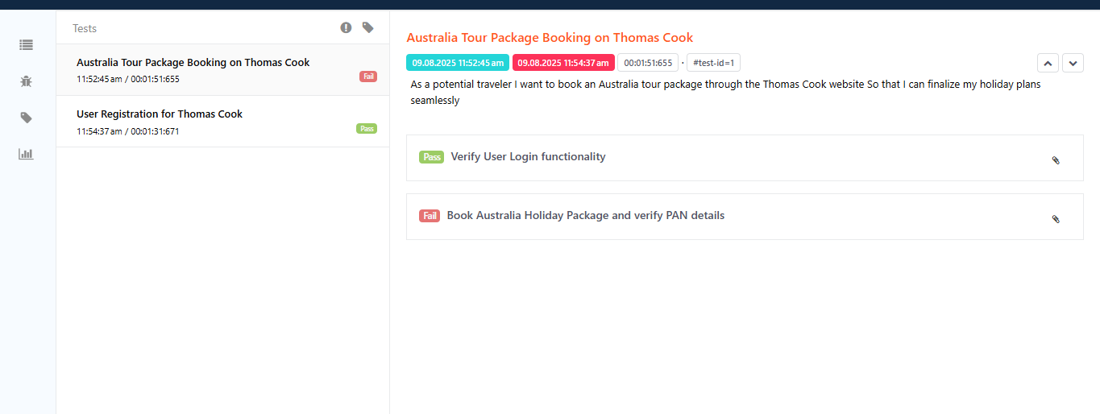
extent.html

Slide 21
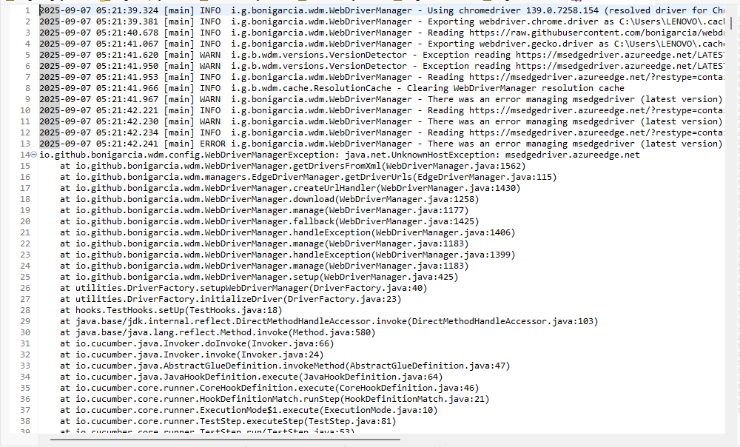
App Log Report

Slide 22
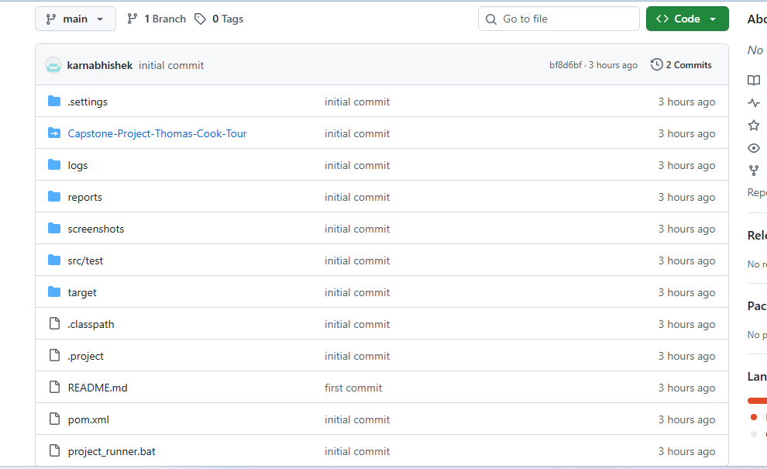
GitHub Repository: https://github.com/karnabhishek/Capstone-Project-Thomas_Cook_Tour.git

Slide 23
Results
• Automation successfully executed Registration workflows.
• Detailed extent reports generated.
• Logs maintained in app.Log file.

Slide 24
Conclusion
• Successfully automated tour package booking workflows.
• Improved efficiency and accuracy compared to manual testing.
• Extent reports provided detailed execution summary.

